Slide 1



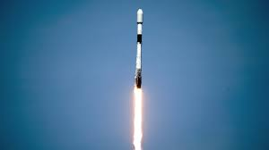

Applied data science capstone By Mariana Santos

Slide 2

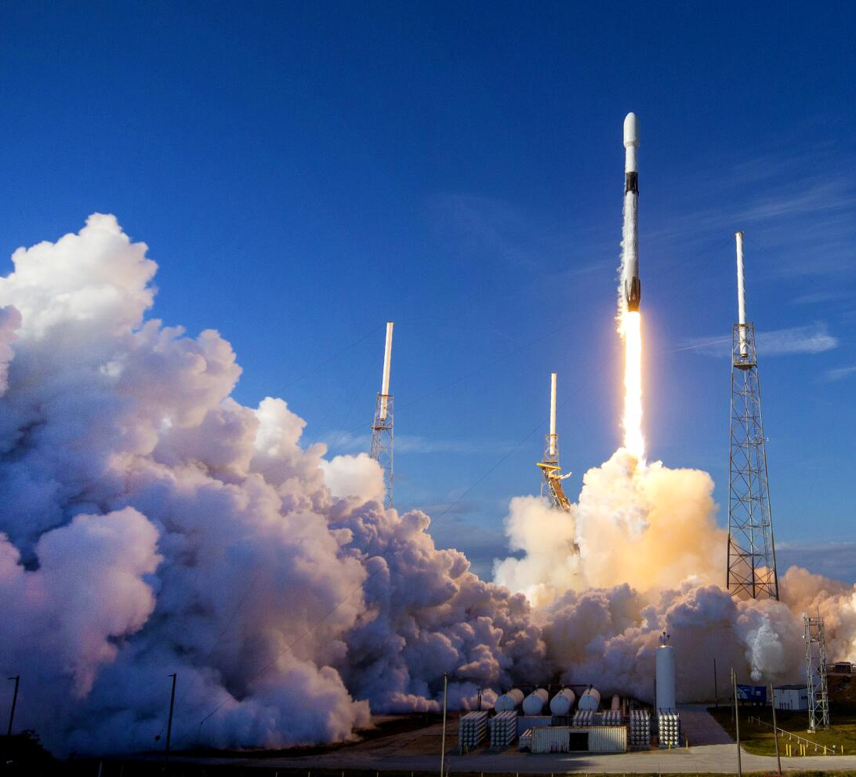
Executive Summary
SpaceX revolutionizes the space industry by offering Falcon 9 rocket launches at a significantly lower cost of 62 million dollars compared to other providers' prices exceeding 165 million dollars per launch. The key to this cost efficiency lies in SpaceX's ability to reuse the first stage of the rocket. By accurately predicting the successful landing of the first stage, it is possible to estimate the total cost of a launch. This crucial information becomes valuable for potential competitors looking to challenge SpaceX in the rocket launch market.

Slide 3
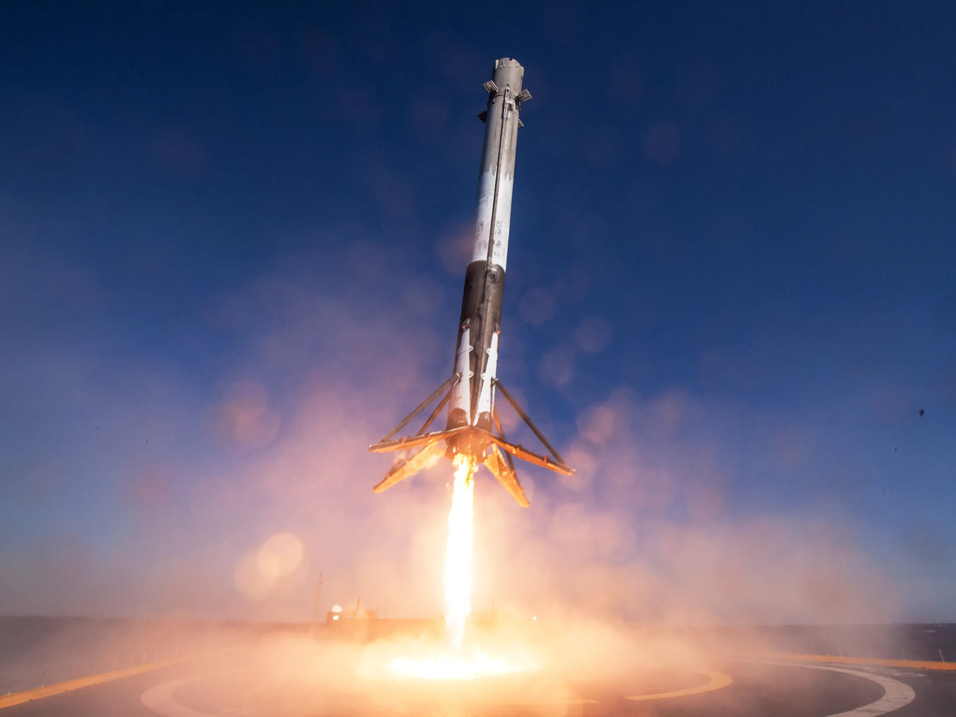
Introduction
SpaceX, a trailblazer in the aerospace industry, has disrupted traditional norms by offering Falcon 9 rocket launches at a fraction of the cost compared to other providers. Priced at 62 million dollars per launch, SpaceX's competitive advantage stems from its innovative approach of reusing the first stage of the Falcon 9 rocket. This cost-saving strategy not only drives down expenses but also sets a new standard for efficiency in space exploration. The ability to predict the successful landing of the first stage plays a pivotal role in determining the overall cost of a launch, giving SpaceX a strategic edge over competitors.
the stage for exploring how data insights can empower informed decision-making and strategic planning in the realm of space technology and exploration.

Slide 4
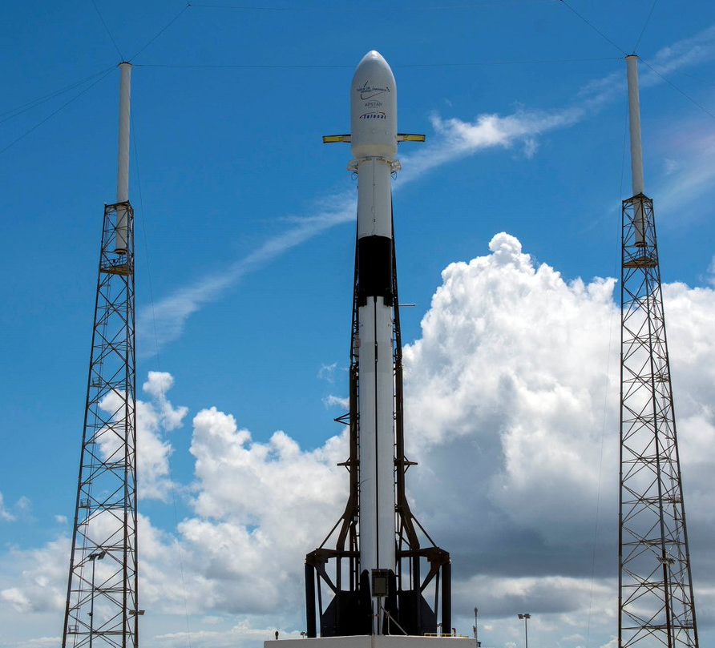
Methodology
Data Collection
Data Collection with Web Scraping
Data Wrangling
Data Analysis using SQL
EDA with Visualization
Interactive Visual Analytics and Dashboard
Predictive Analysis

Slide 5
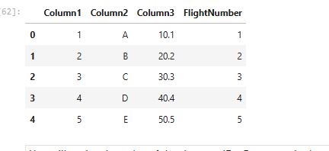
Data collection and data wrangling

Slide 6
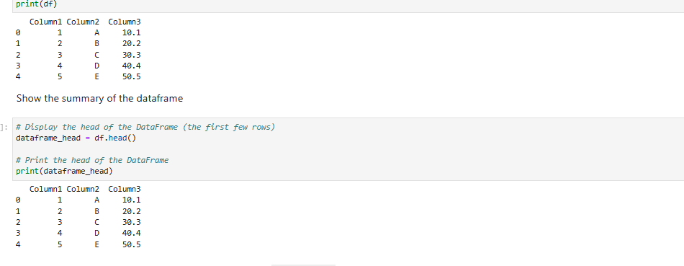
Data collection and data wrangling

Slide 7
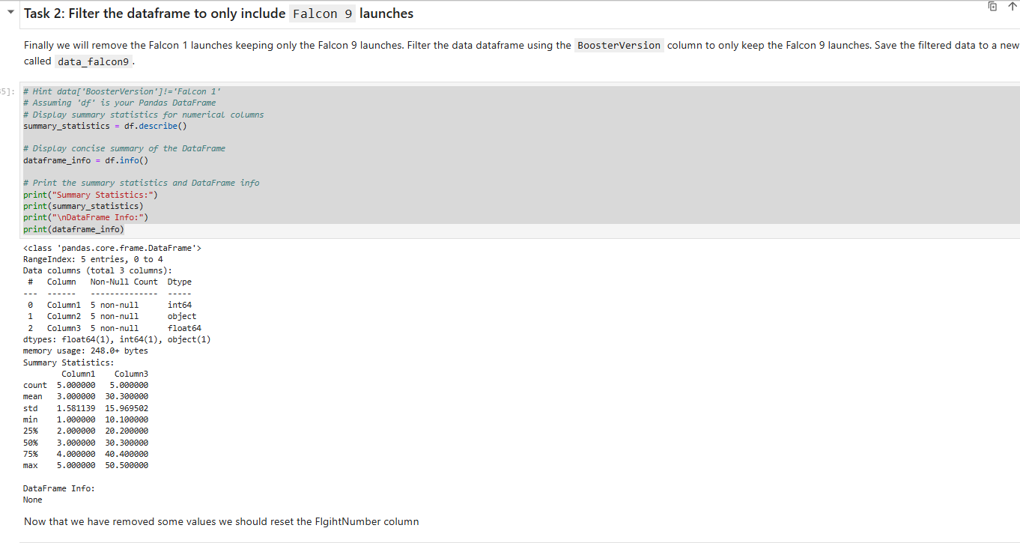
Data collection and data wrangling

Slide 8
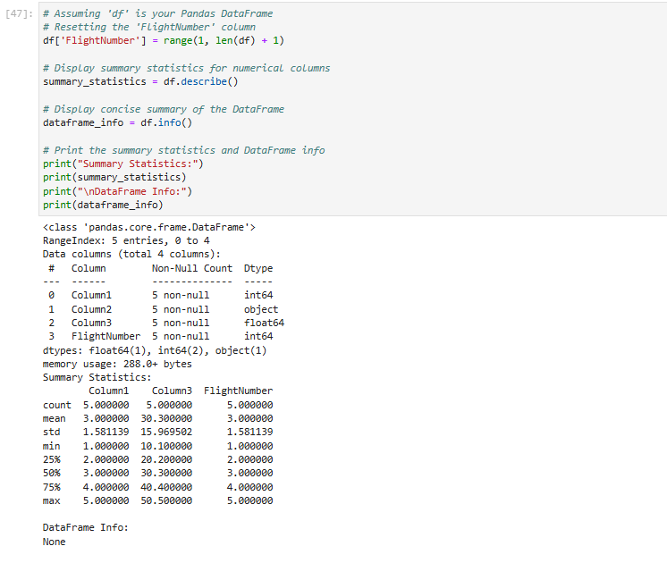
Data collection and data wrangling

Slide 9
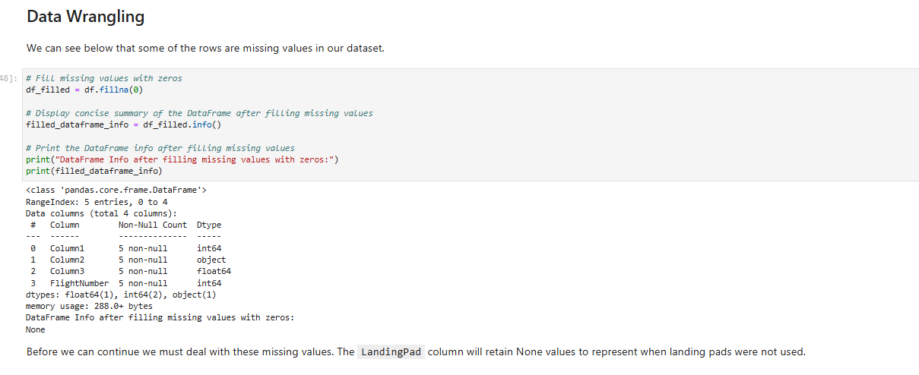
data wrangling

Slide 10
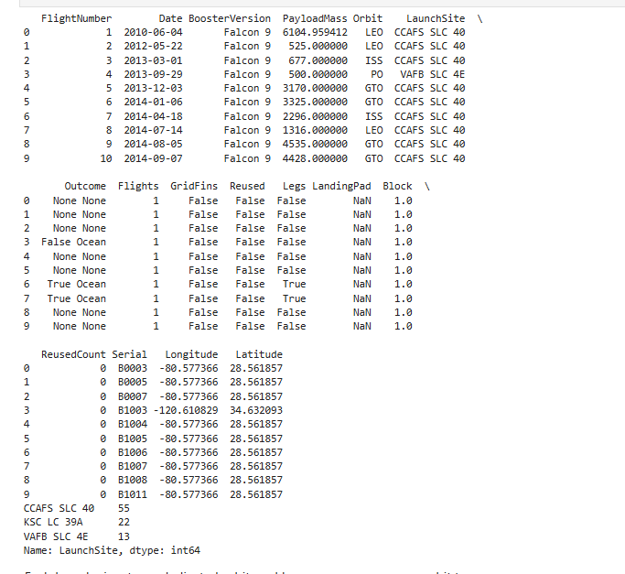

data wrangling

Slide 11
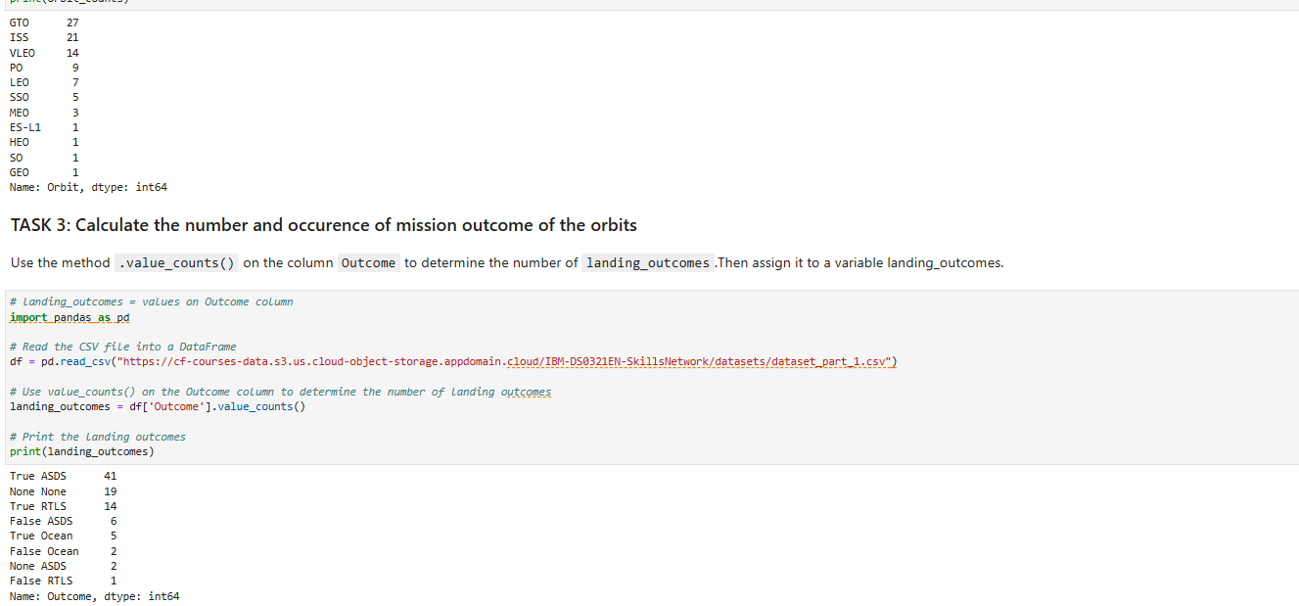
data wrangling

Slide 12
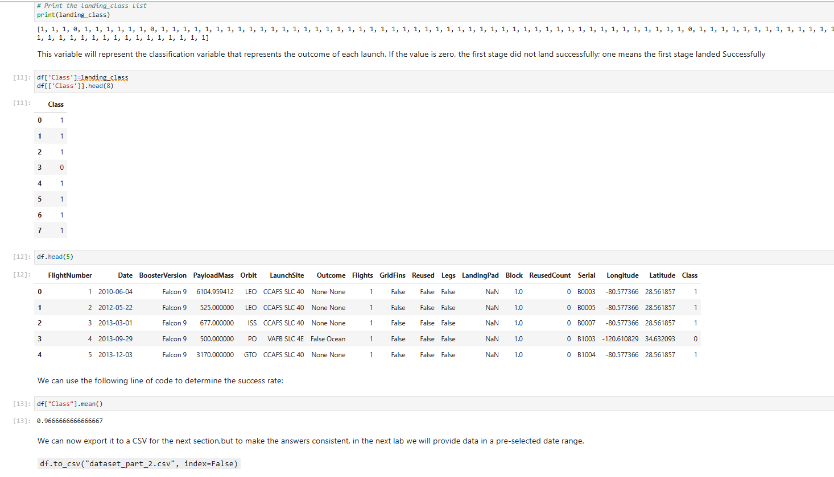
data wrangling

Slide 13
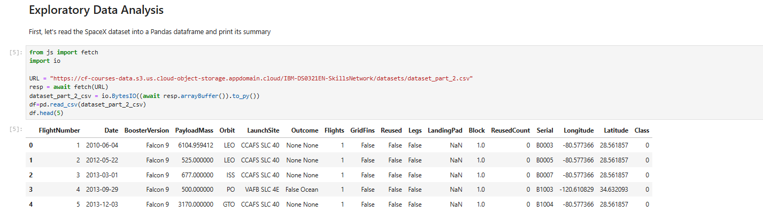
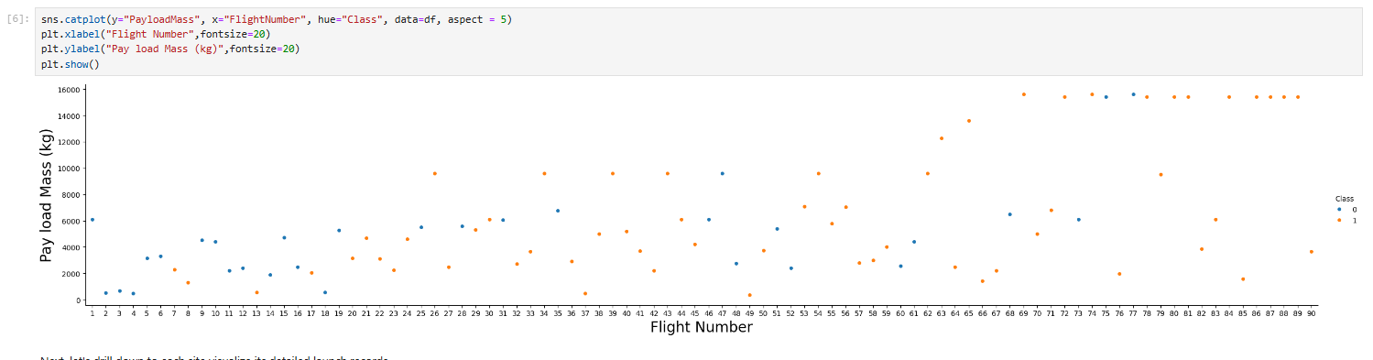
Eda and interactive visual analytics

Slide 14
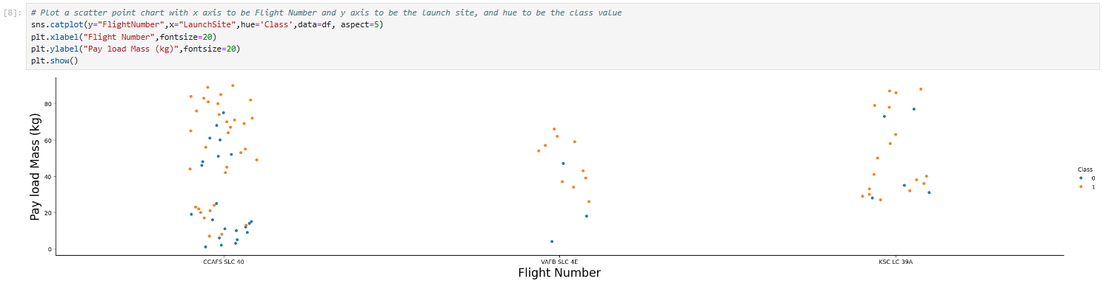
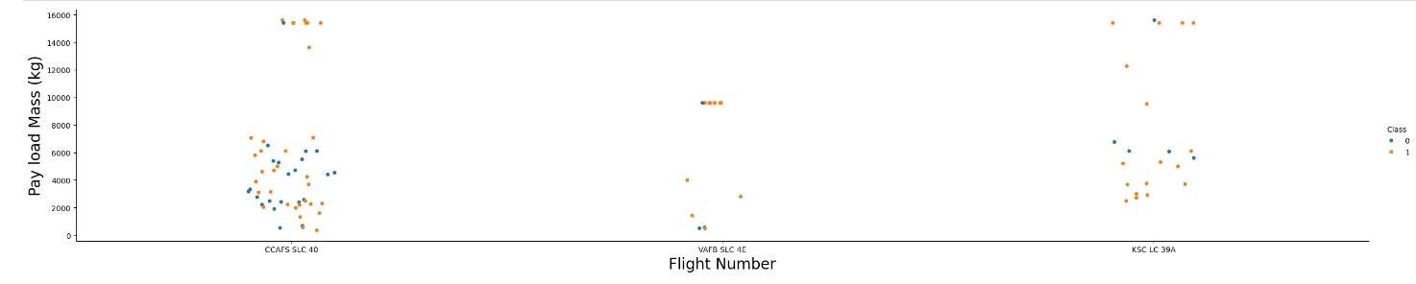
Eda and interactive visual analytics

Slide 15
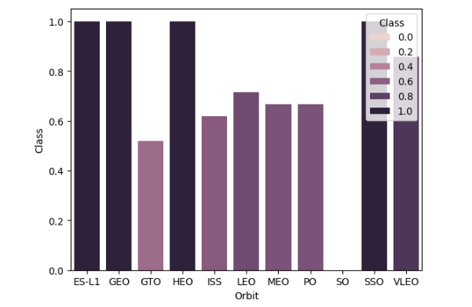
Eda and interactive visual analytics

Slide 16
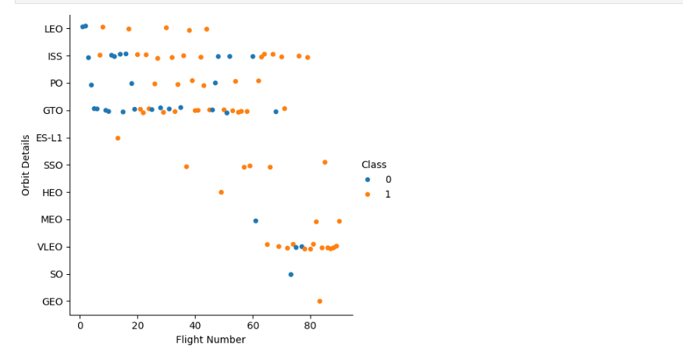
Eda and interactive visual analytics

Slide 17
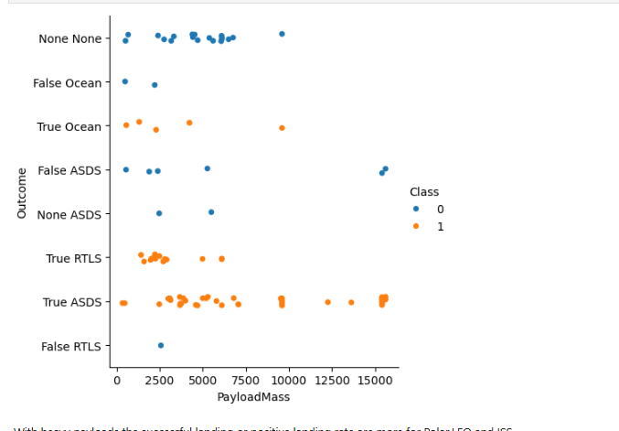
Eda and interactive visual analytics

Slide 18
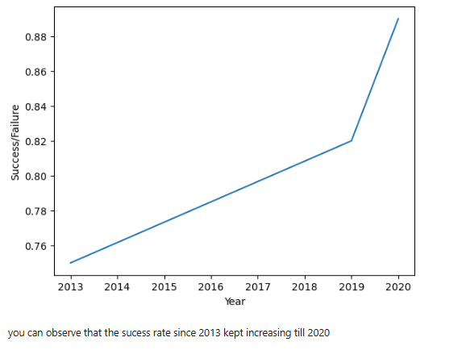
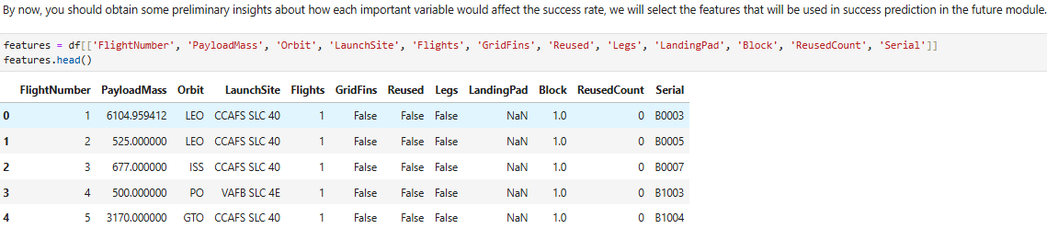
Eda and interactive visual analytics

Slide 19
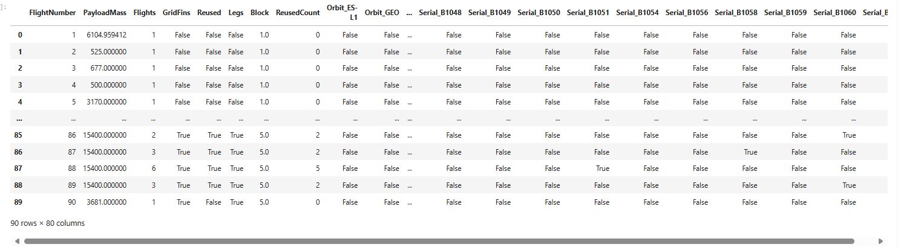
Eda and interactive visual analytics

Slide 20
Predictive analysis methodology
Build a machine-learning pipeline
Predict whether the first stage of Falcon 9 will land successfully
Reprocessing
Train Test Split
Train
Grid Search
Test

Slide 21
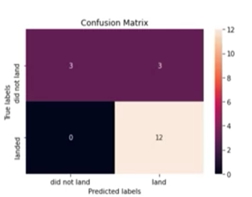
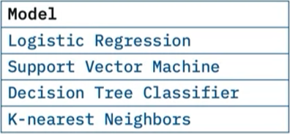
Determine model with best accuracy
Test

Slide 22
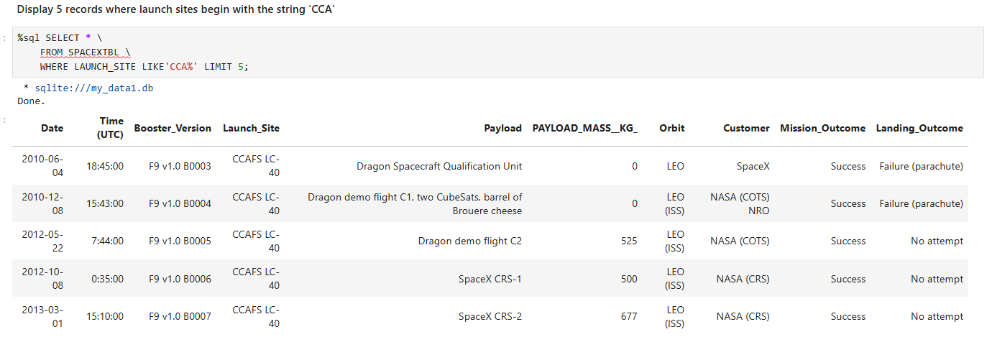
Eda with Visualization SQL

Slide 23
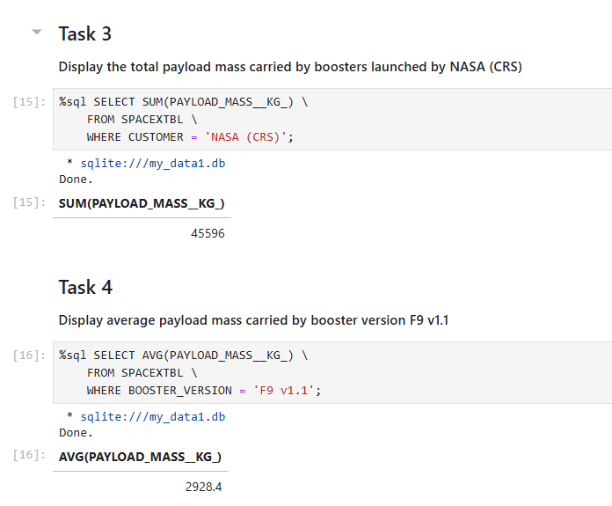
Eda with sql results

Slide 24
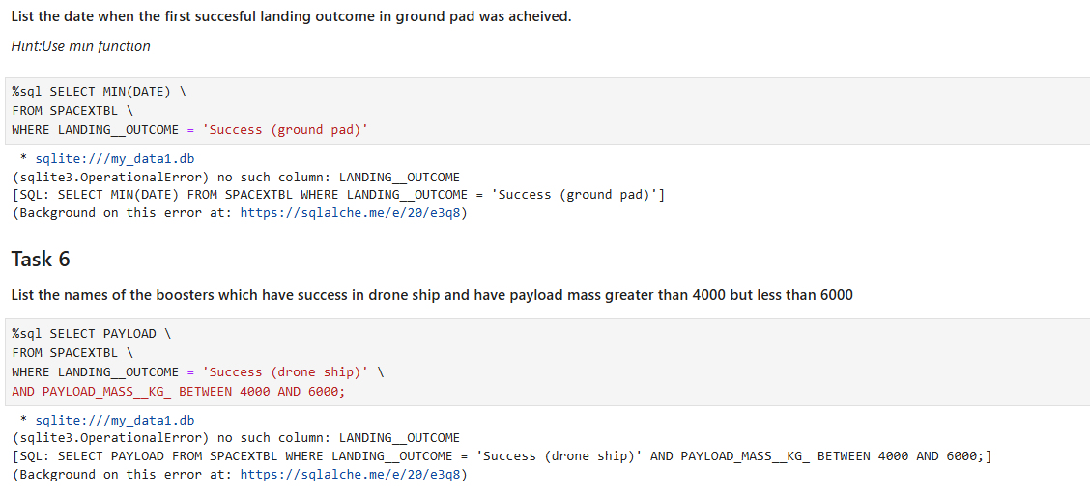
Eda with sql results

Slide 25
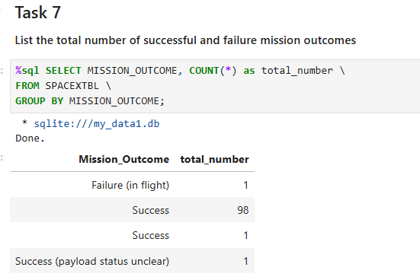
Eda with sql results

Slide 26
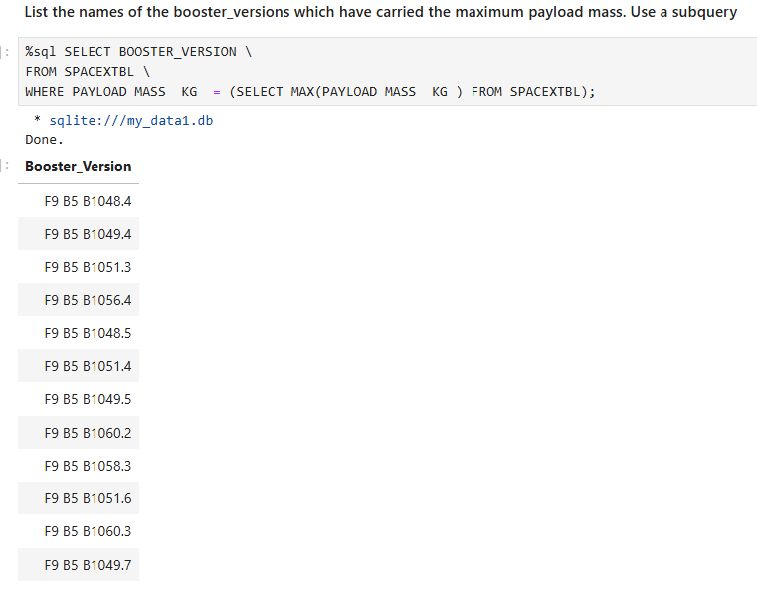
Eda with sql results

Slide 27
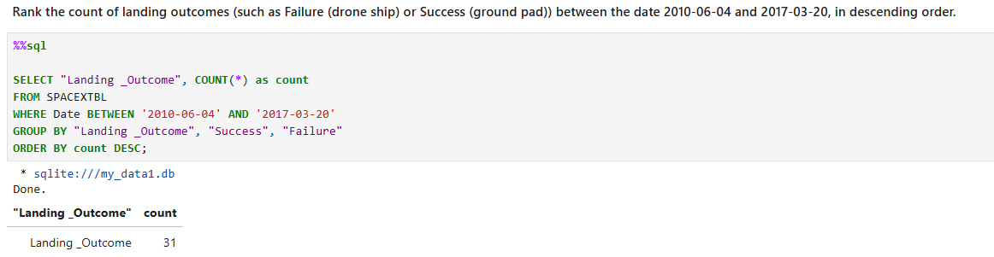
Eda with sql results

Slide 28
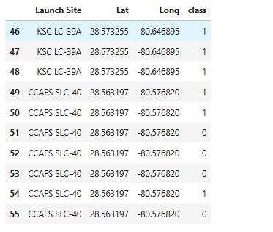
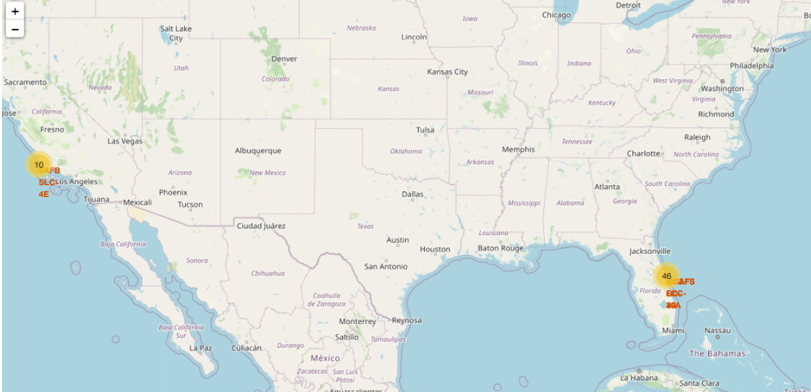
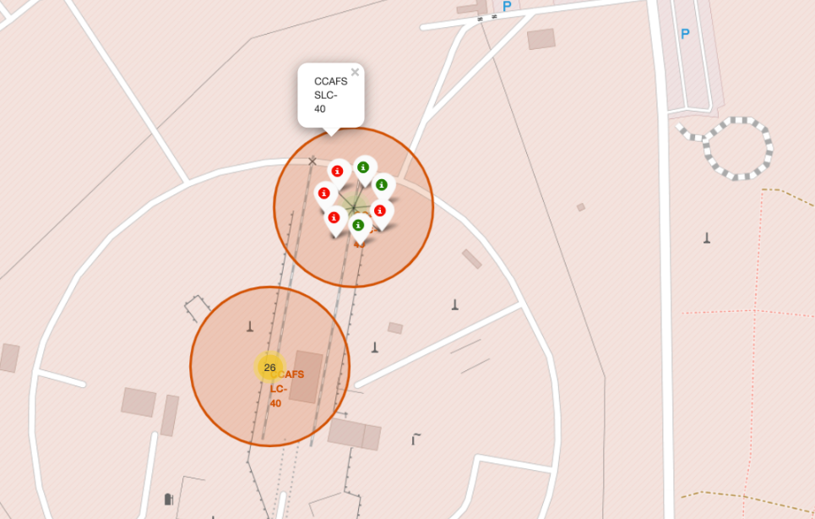
Required interactive map with folium results

Slide 29
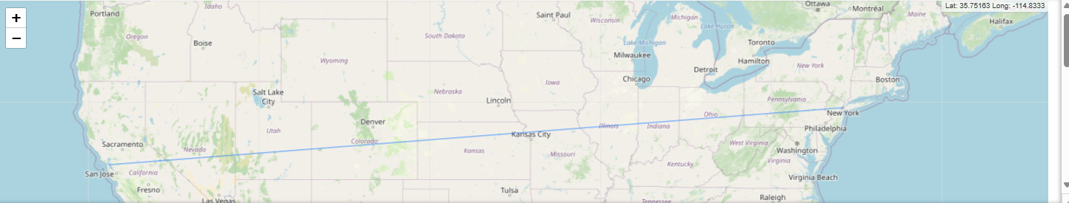
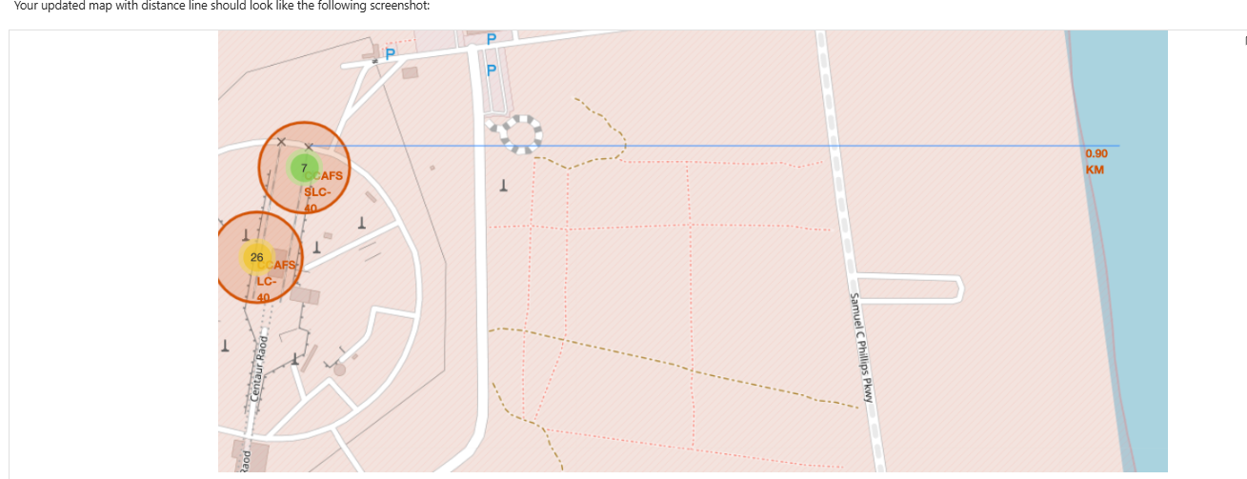
Required interactive map with folium results

Slide 30
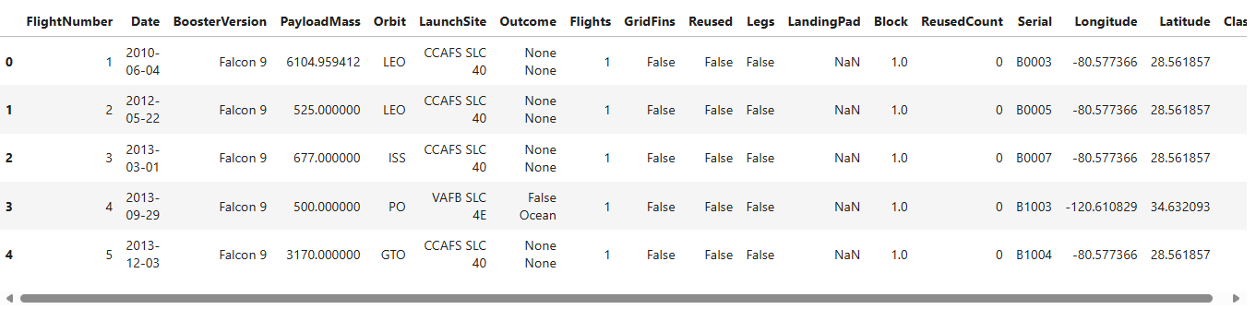
Predictive analysis (classification)

Slide 31
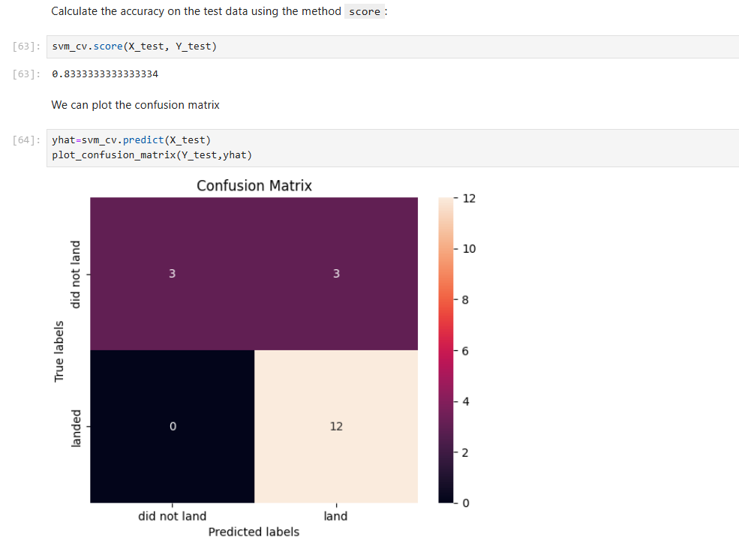
Predictive analysis (classification)

Slide 32
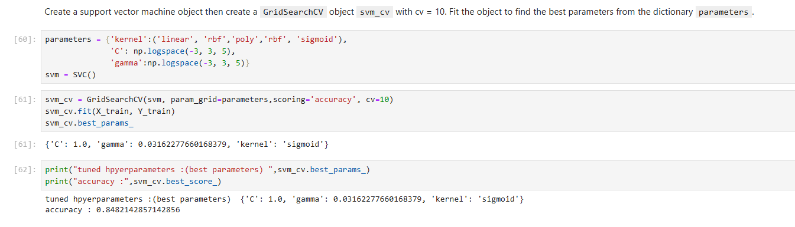
Predictive analysis (classification)

Slide 33
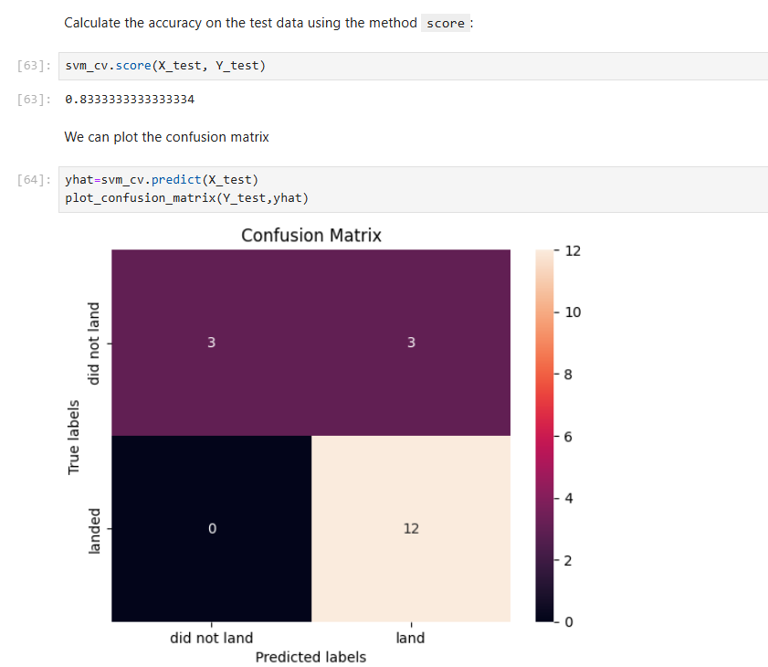
Predictive analysis (classification)

Slide 34
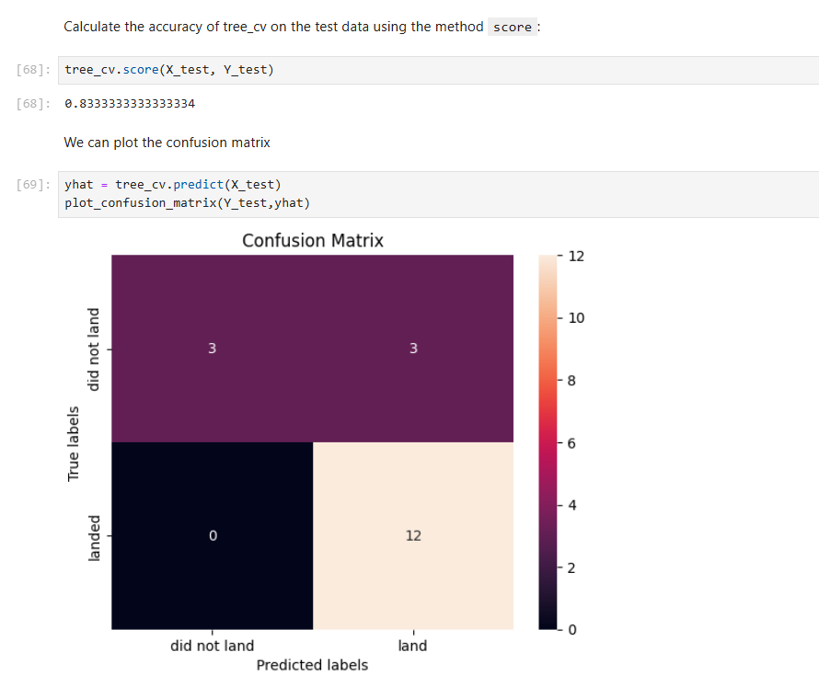
Predictive analysis (classification)

Slide 35
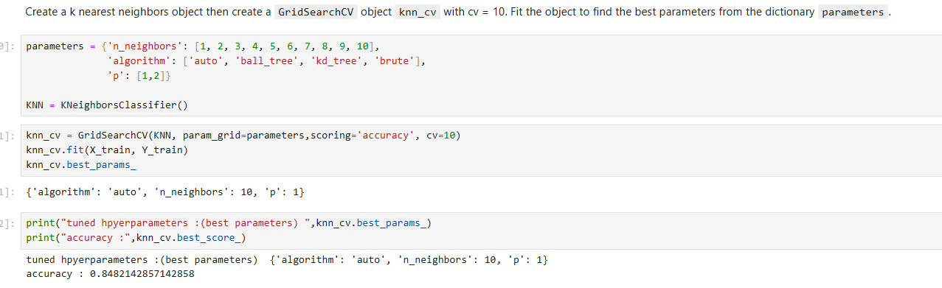
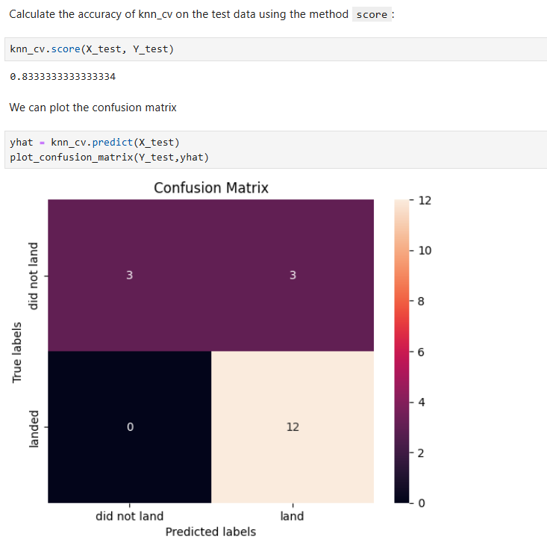
Predictive analysis (classification)

Slide 36
conclusion
Every method used is around the 0.83 number however, some numbers were 0.84
Comparing models consistently across various studies proves difficult, as there is currently no tool available to assess models using identical performance metrics.

Slide 37
Innovative insights
Performance Evaluation: Accuracy serves as a primary performance evaluation metric, indicating the percentage of correctly predicted instances by a model. It helps gauge the model's effectiveness in making precise decisions based on the available data.
Model Optimization: Improving accuracy involves optimizing the model through techniques like feature selection, hyperparameter tuning, and data preprocessing. Enhancing accuracy leads to more reliable predictions and better outcomes in real-world scenarios.

